Slide 1
Machine Learning 101

Slide 2
Notes:
The McGill initiative on Computational Medicine was formed in 2017 and aims to deliver inter-disciplinary research programs and empower the use of data in health research and health care delivery
Located at the Genome Center
They have a newsletter were you can subscribe to
more info on the web site

Slide 4
Personal Introduction
Abdelrahman Ayad
PhD student – ECE department McGill University
Research area: modern power systems and energy systems modeling
Triathlon, skydiving, and reading

Slide 5
Personal Introduction
Audrey Baguette
PhD student - Quantitative Life Sciences
3D conformation of chromatin and its relation to gene expression

Slide 6
Workshop agenda
Machine Learning (ML) introduction
ML models, tasks, and important concepts
Decision Trees (DTs)
Concepts
Coding exercise
Artificial Neural Networks (ANNs)
Concepts
Coding exercise
Coding competition
Next steps
Q&A

Slide 7

Terminologies
Artificial Intelligence (AI)
Broader science (domain) of incorporating human intelligence to machines
Machine Learning (ML)
Subset of AI, provides computer ability to learn and improve from experience
Many algorithms: Artificial Neural Networks (ANNs), Support Vector Machines (SVM), Decision Trees (DTs) , …
Deep Learning (DL)
Evolution of ML
Advanced models of ANN
Extracting and finding features
Data Science
Umbrella term for the above
Widely used in industry
Includes data mining
https://blogs.nvidia.com/blog/2016/07/29/whats-difference-artificial-intelligence-machine-learning-deep-learning-ai/

Slide 8
ML definitions
Technical definition
“A computer program is said to learn from experience E with respect to some class of tasks T and performance measure P, if its performance at tasks in T, as measured by P, improves with experience E” - Tom Mitchel
Less formal
“Computer systems that automatically improve with experience”

Slide 9
ML broad tasks
Classification
Output: Binary or multiple classes
E.g., images classification, cancer detection, email spams
Regression
Output: Continuous or discrete
E.g., weather forecasting, stock price prediction
Clustering
Partitioning data into regions
Not an exhaustive list

Slide 10
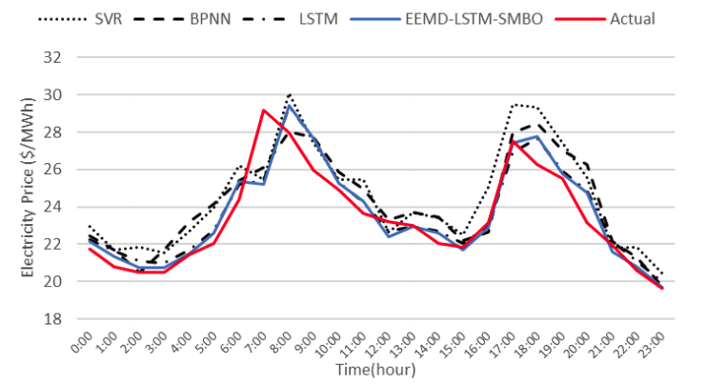
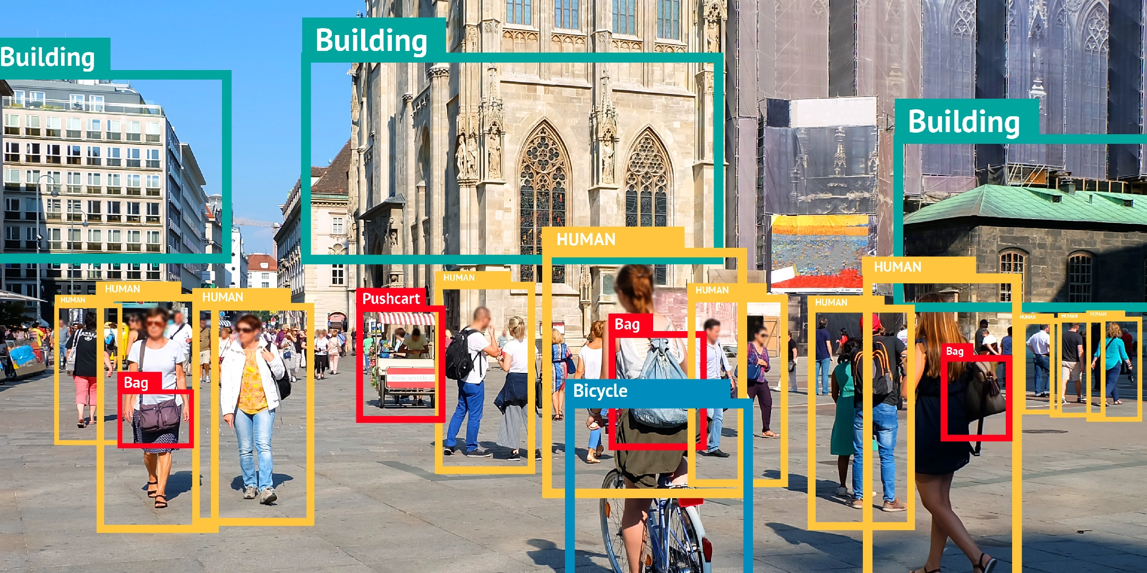
ML models
Supervised learning
We have labeled data
Classification, regression, ranking
Zhou et al. “An Optimized heterogeneous structure LSTM Network for Price Forecasting”, 2019.
https://bitmovin.com/object-detection/

Slide 11
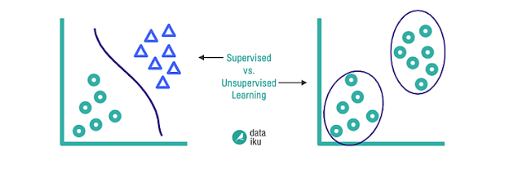
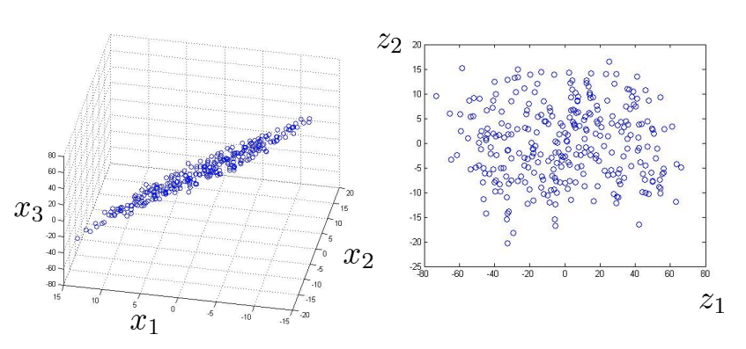
ML models
Unsupervised learning
We don’t provide labels
Clustering, dimensionality reduction
https://blog.dataiku.com/clustering-how-it-works-in-plain-english

Slide 12
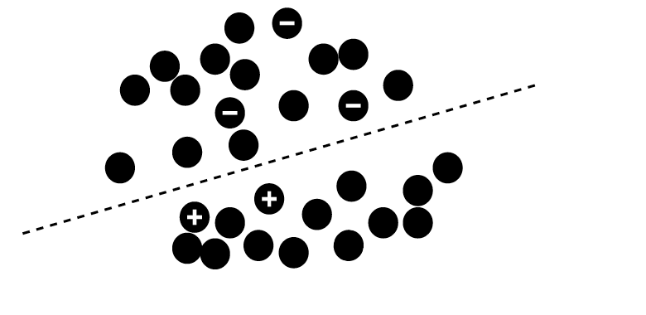
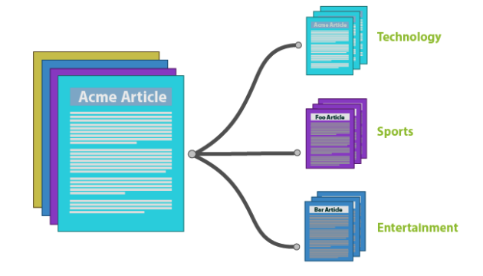
ML models
Semi-supervised learning
Only a subset of data is labeled
https://github.com/javedsha/text-classification

Slide 13
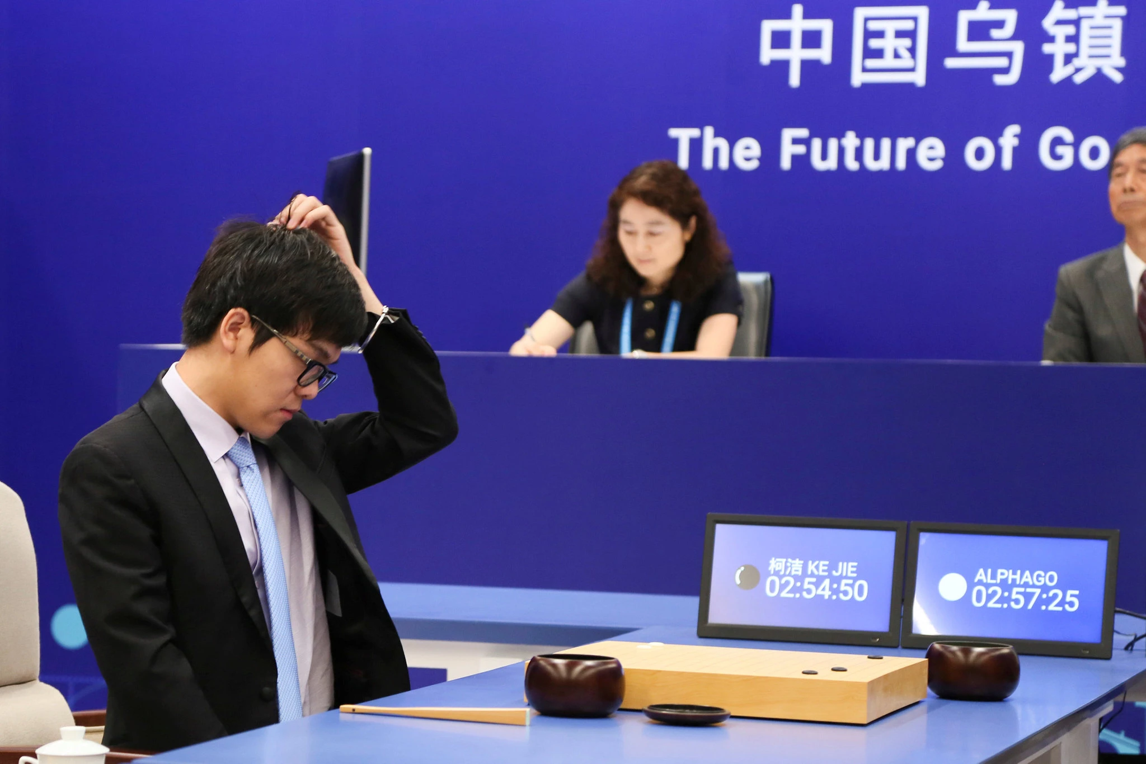
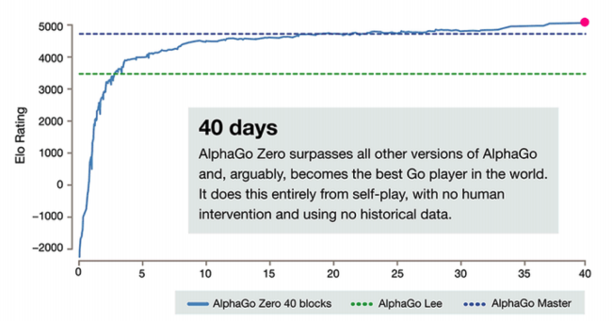
ML models
Unsupervised learning
Reinforcement learning
Agent that gets explores an environment and gets rewards
Ke Jie, the world’s top Go player, reacting during his match on Tuesday against AlphaGo, artificial intelligence software developed by a Google affiliate. Credit...China Stringer Network, via Reuters. May 23, 2017
https://deepmind.com/blog/article/alphago-zero-starting-scratch

Slide 14
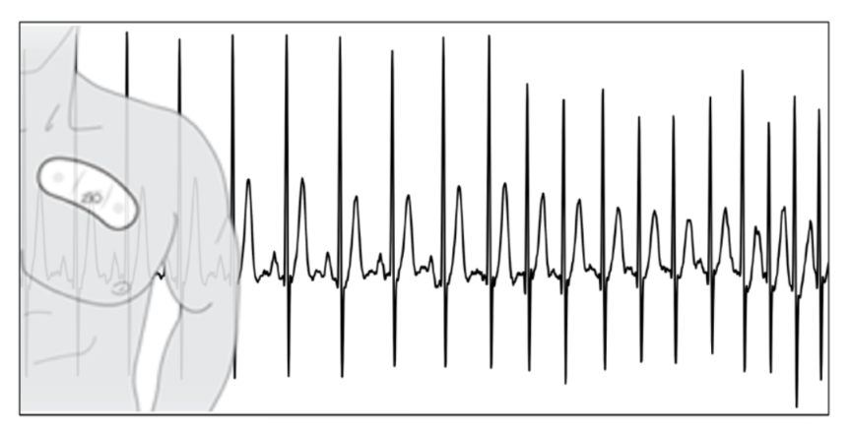
ML applications
Theoretical vs Applied ML
Importance of domain knowledge
Data preprocessing
Results interpretation
ECG data: Rajpurkar et al., 2017

Slide 15
ML main concepts
Learning = Representation + Evaluation + Optimization
Representation: Features Space
Evaluation: Objective function
Measure how good the model is
Error between prediction and actual target
Optimization: Improve and minimize the error
Adjust model parameters to decrease error
Repeat until convergence

Slide 16
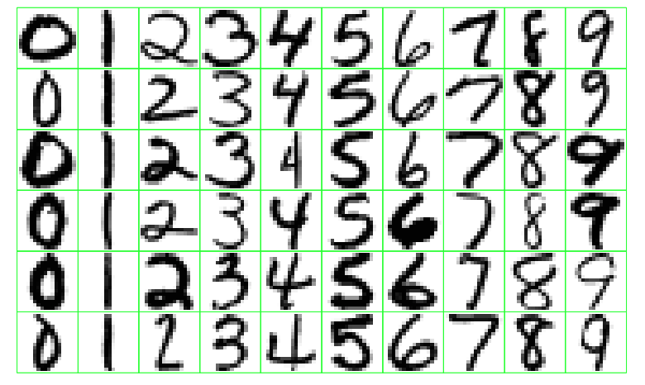
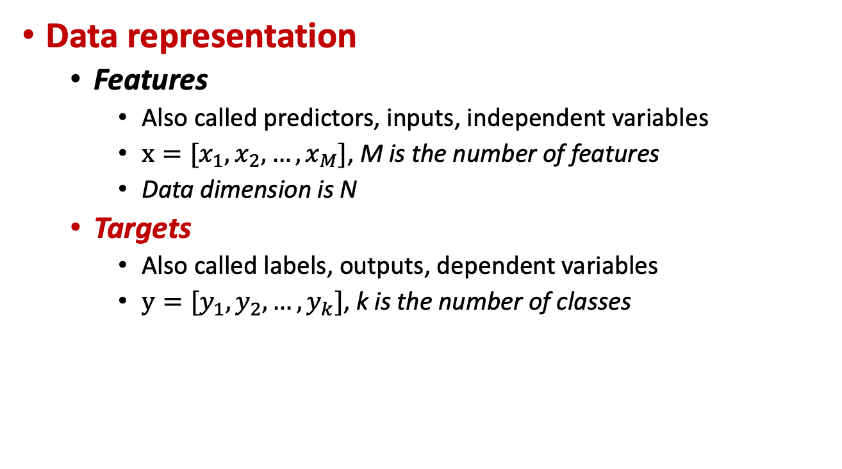
ML main concepts
Data representation
Features
Also called predictors, inputs, independent variables
$x=[x_{1}, x_{2}, …, x_{M}]$, M is the number of features
Data dimension is N
Targets
Also called labels, outputs, dependent variables
$y=[y_{1}, y_{2}, …, y_{k}]$, k is the number of classes
Classes
N Samples

Slide 17
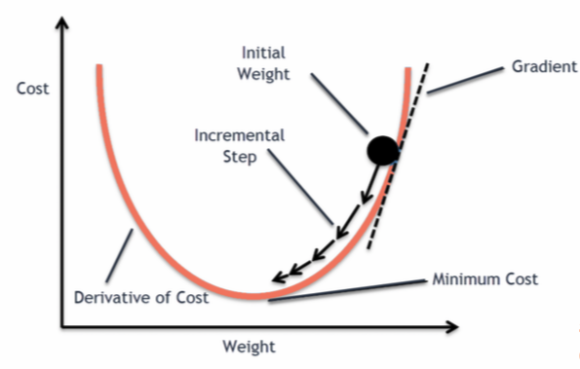
ML main concepts
Optimization: Minimize an objective function
What is a learning algorithm?
Iterative approach
E.g., Gradient descent
https://blog.clairvoyantsoft.com/the-ascent-of-gradient-descent-23356390836f

Slide 18
ML main concepts
Building a model
Objective definition
Data preparation
Model selection
1
Training
Evaluation
Parameters tuning
Learning
2
Predicting
3
Inference
Final model

Slide 19
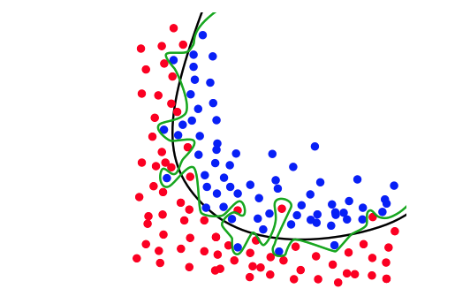
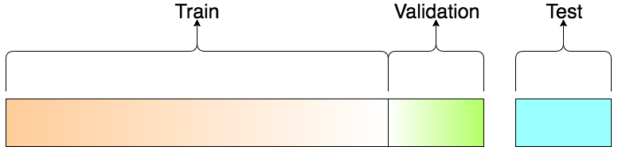
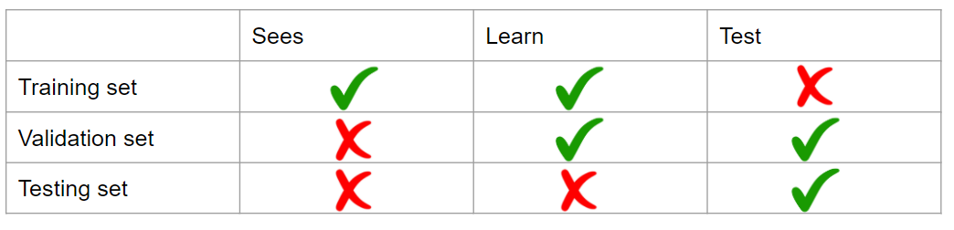
ML main concepts
Data split into training and testing sets
Avoids overfitting
Important for generalization in the real world
Cross validation
https://elitedatascience.com/overfitting-in-machine-learning

Slide 20
Decision Trees (DTs)
Main idea: Divide space into regions using a tree structure
Classification tasks: class label
Regression tasks: real scalar
Motivation:
Handling of categorical variables.
Handling of missing values and unknown values.
Detection of non-linear relationships.
Visualization and interpretation in decision trees.

Slide 21
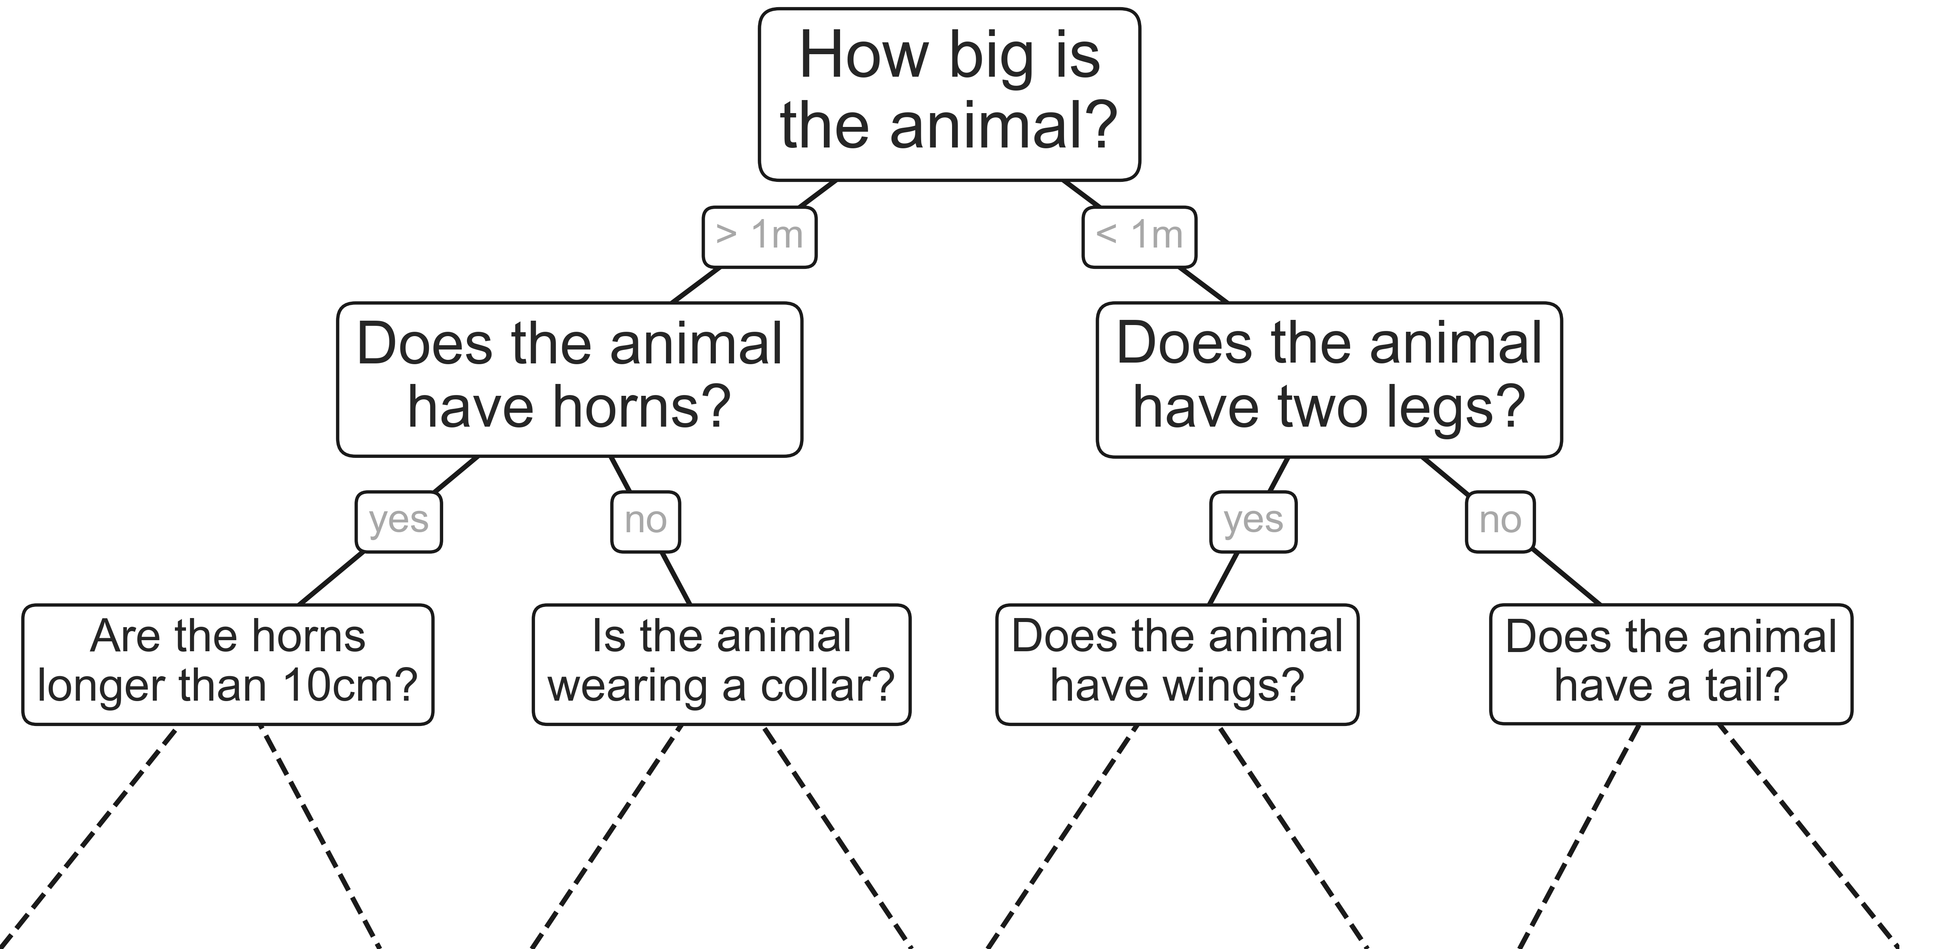
DTs motivation
Intuitive way to classify objects
Series of questions
Split based on answer = threshold
E.g., classify animals

Slide 22
DTs motivation
Intuitive way to classify objects
Series of questions
Split based on answer = threshold
E.g., classify animals

Slide 23
DTs motivation
Intuitive way to classify objects
Series of questions
Split based on answer = threshold
E.g., classify animals

Slide 24
DTs motivation
Intuitive way to classify objects
Series of questions
Split based on answer = threshold
E.g., classify animals

Slide 25
DTs motivation
Intuitive way to classify objects
Series of questions
Split based on answer = threshold
E.g., classify animals

Slide 26
DTs motivation
Intuitive way to classify objects
Series of questions
Split based on answer = threshold
E.g., classify animals

Slide 27
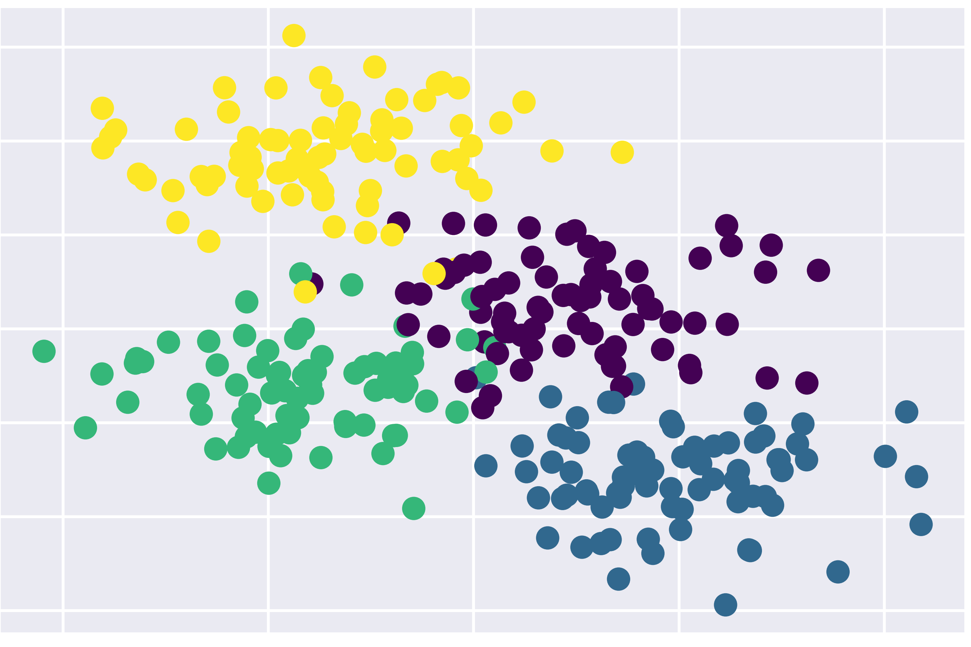
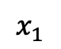
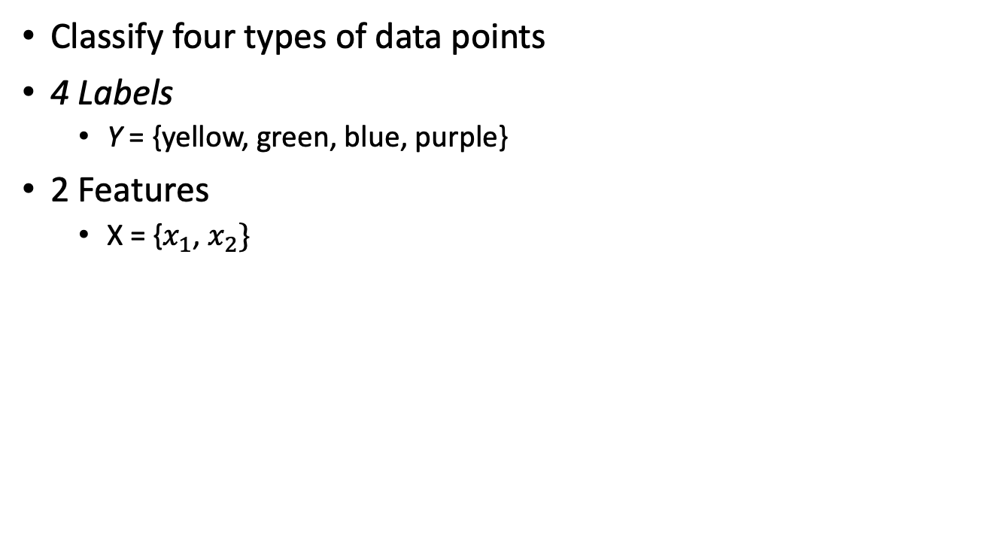
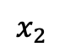
DTs example
Classify four types of data points
4 Labels
Y = {yellow, green, blue, purple}
2 Features
X = {$x_{1}$, $x_{2}\}$
$$x_{2}$$
$$x_{1}$$

Slide 28
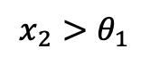
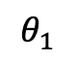
DTs example
$$x_{2}>θ_{1}$$
$$x_{2}$$
$$θ_{1}$$
$$x_{1}$$

Slide 29
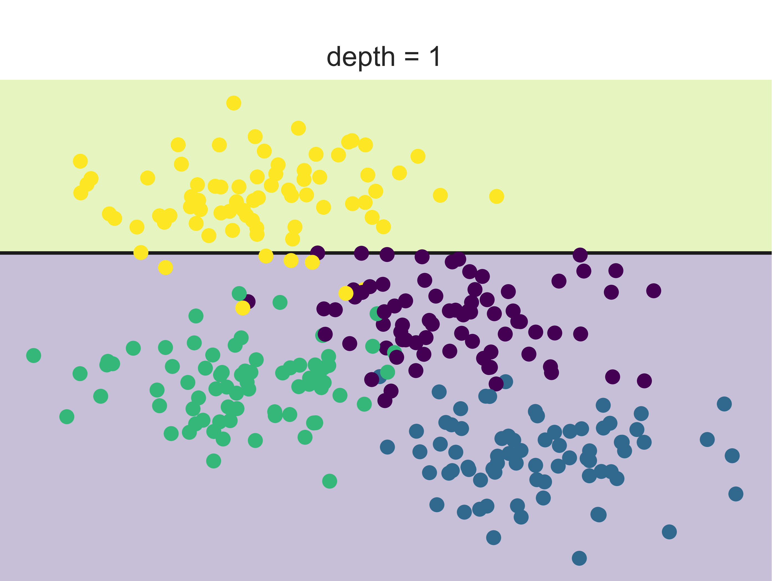
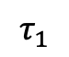
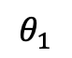
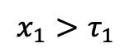
DTs example
$$x_{2}>θ_{1}$$
$$x_{1}>τ_{1}$$
$$x_{2}$$
yellow
$$θ_{1}$$
$$τ_{1}$$
$$x_{1}$$

Slide 30
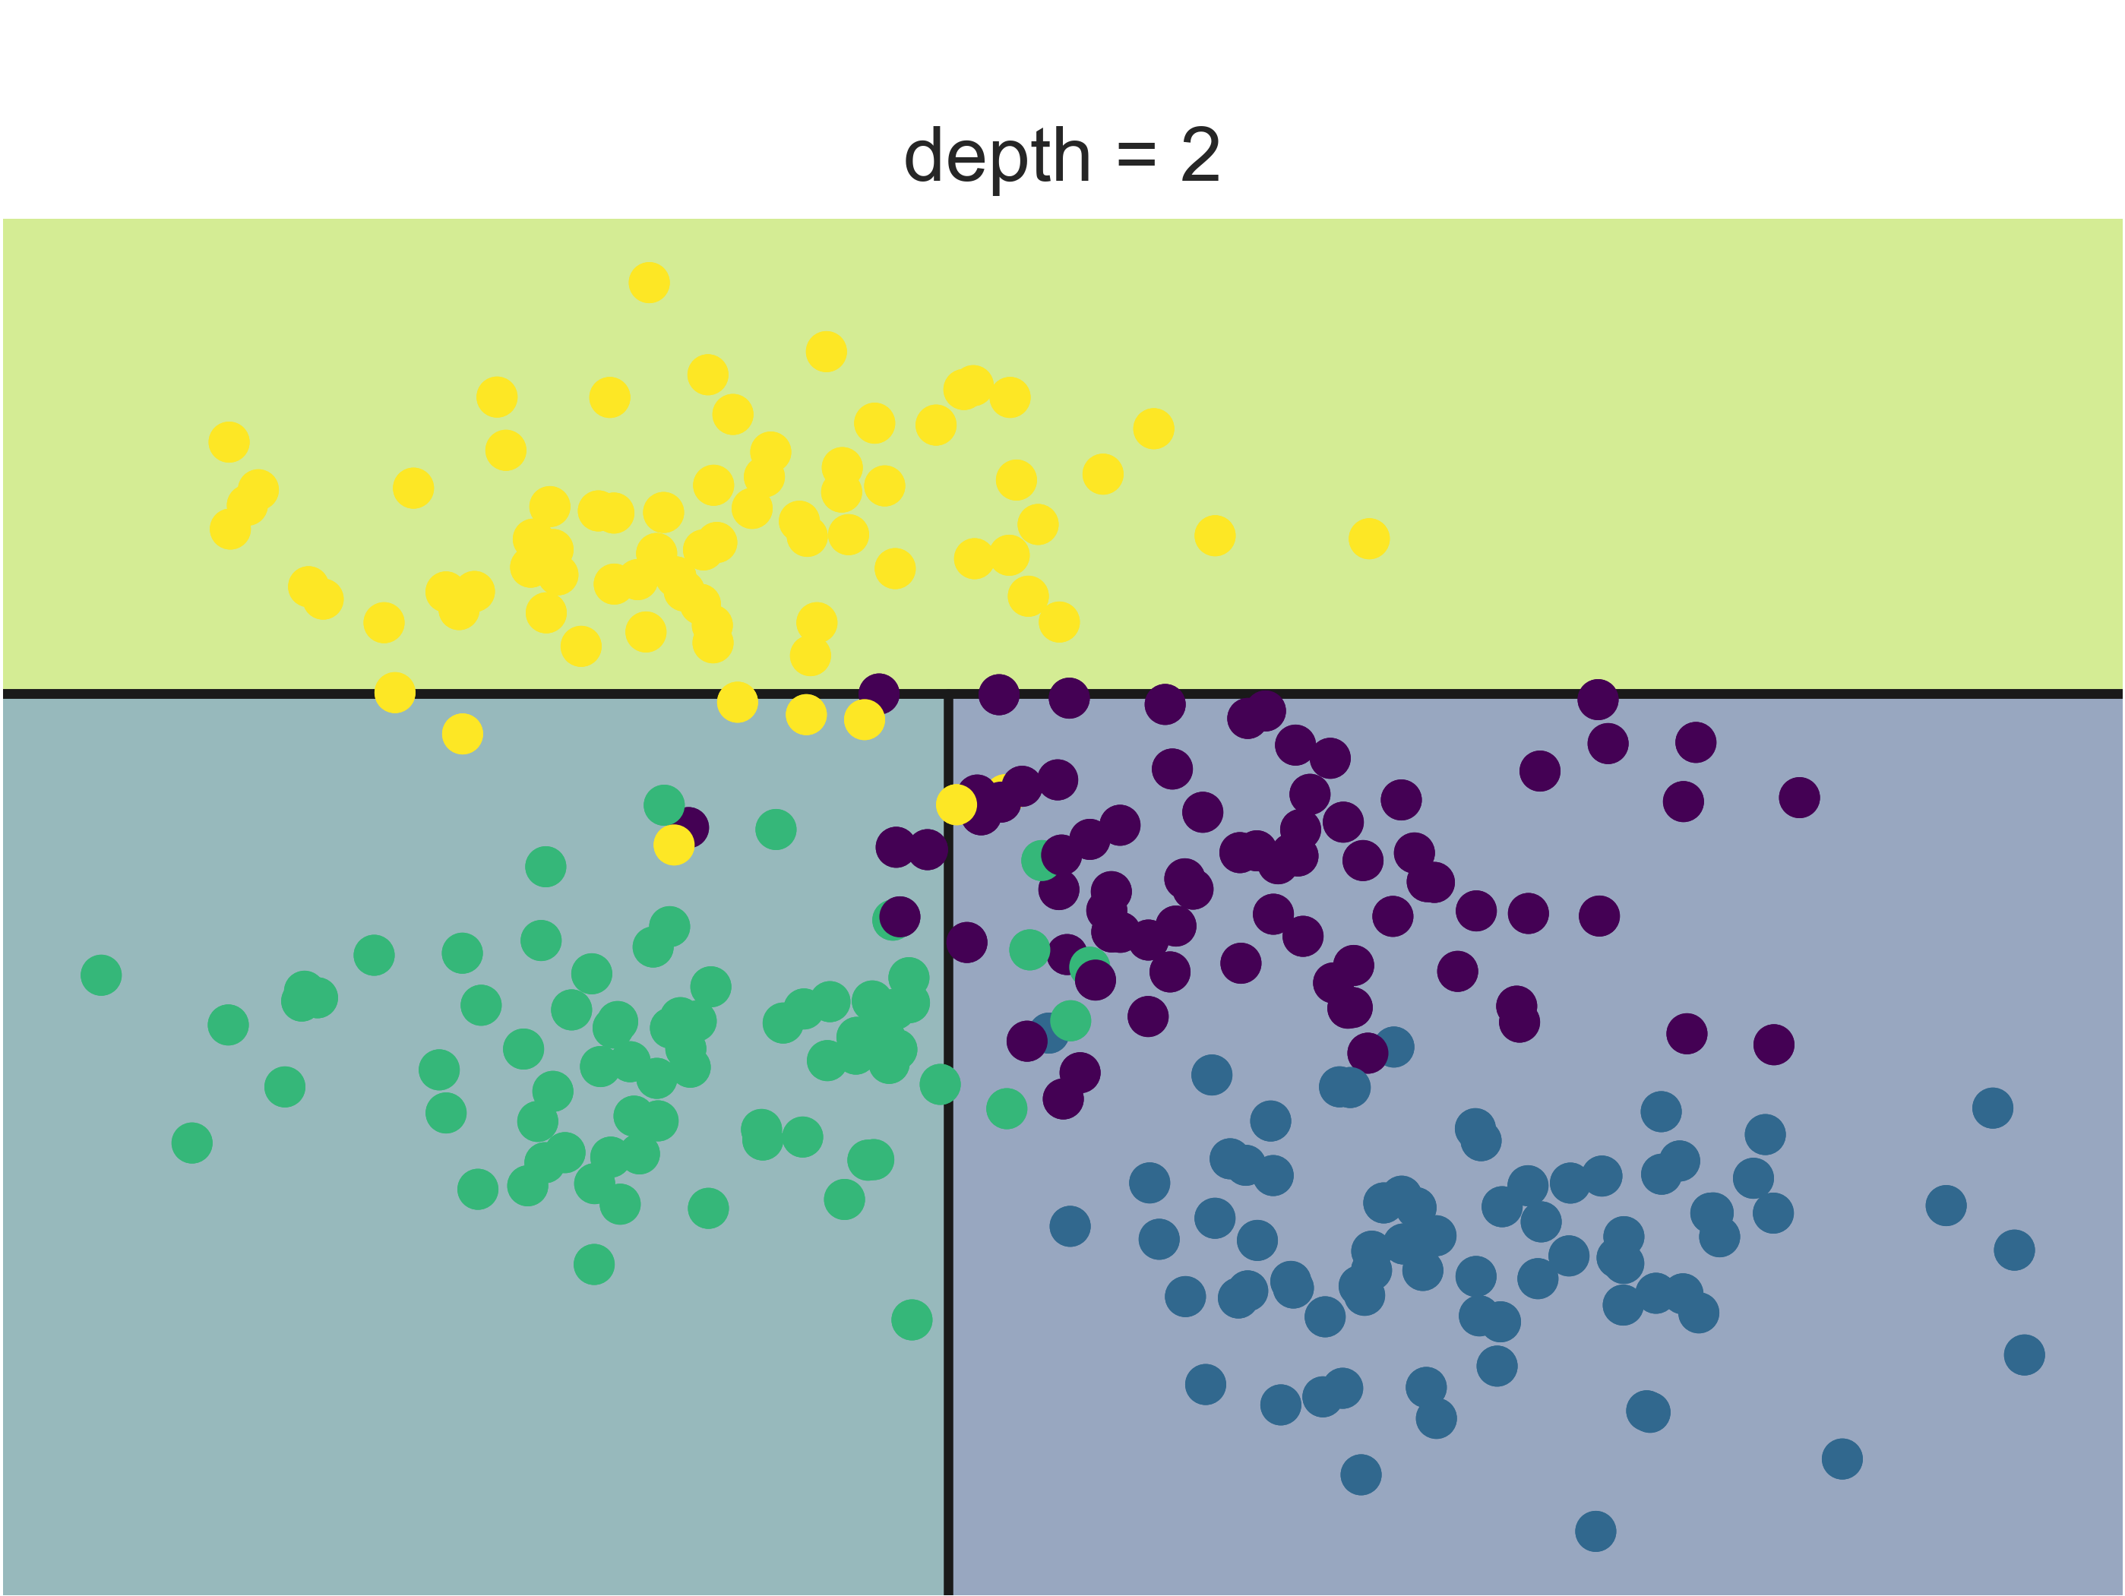
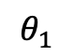
DTs example
$$x_{2}>θ_{1}$$
$$x_{1}>τ_{1}$$
$$x_{2}$$
yellow
$$θ_{1}$$
Green
$$τ_{1}$$
$$x_{1}$$

Slide 31
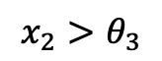
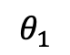
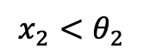
DTs example
$$x_{2}>θ_{1}$$
$$x_{1}>τ_{1}$$
$$x_{2}$$
yellow
$$θ_{1}$$
$$x_{2}<θ_{2}$$
$$x_{2}>θ_{3}$$
$$τ_{1}$$
$$x_{1}$$

Slide 32
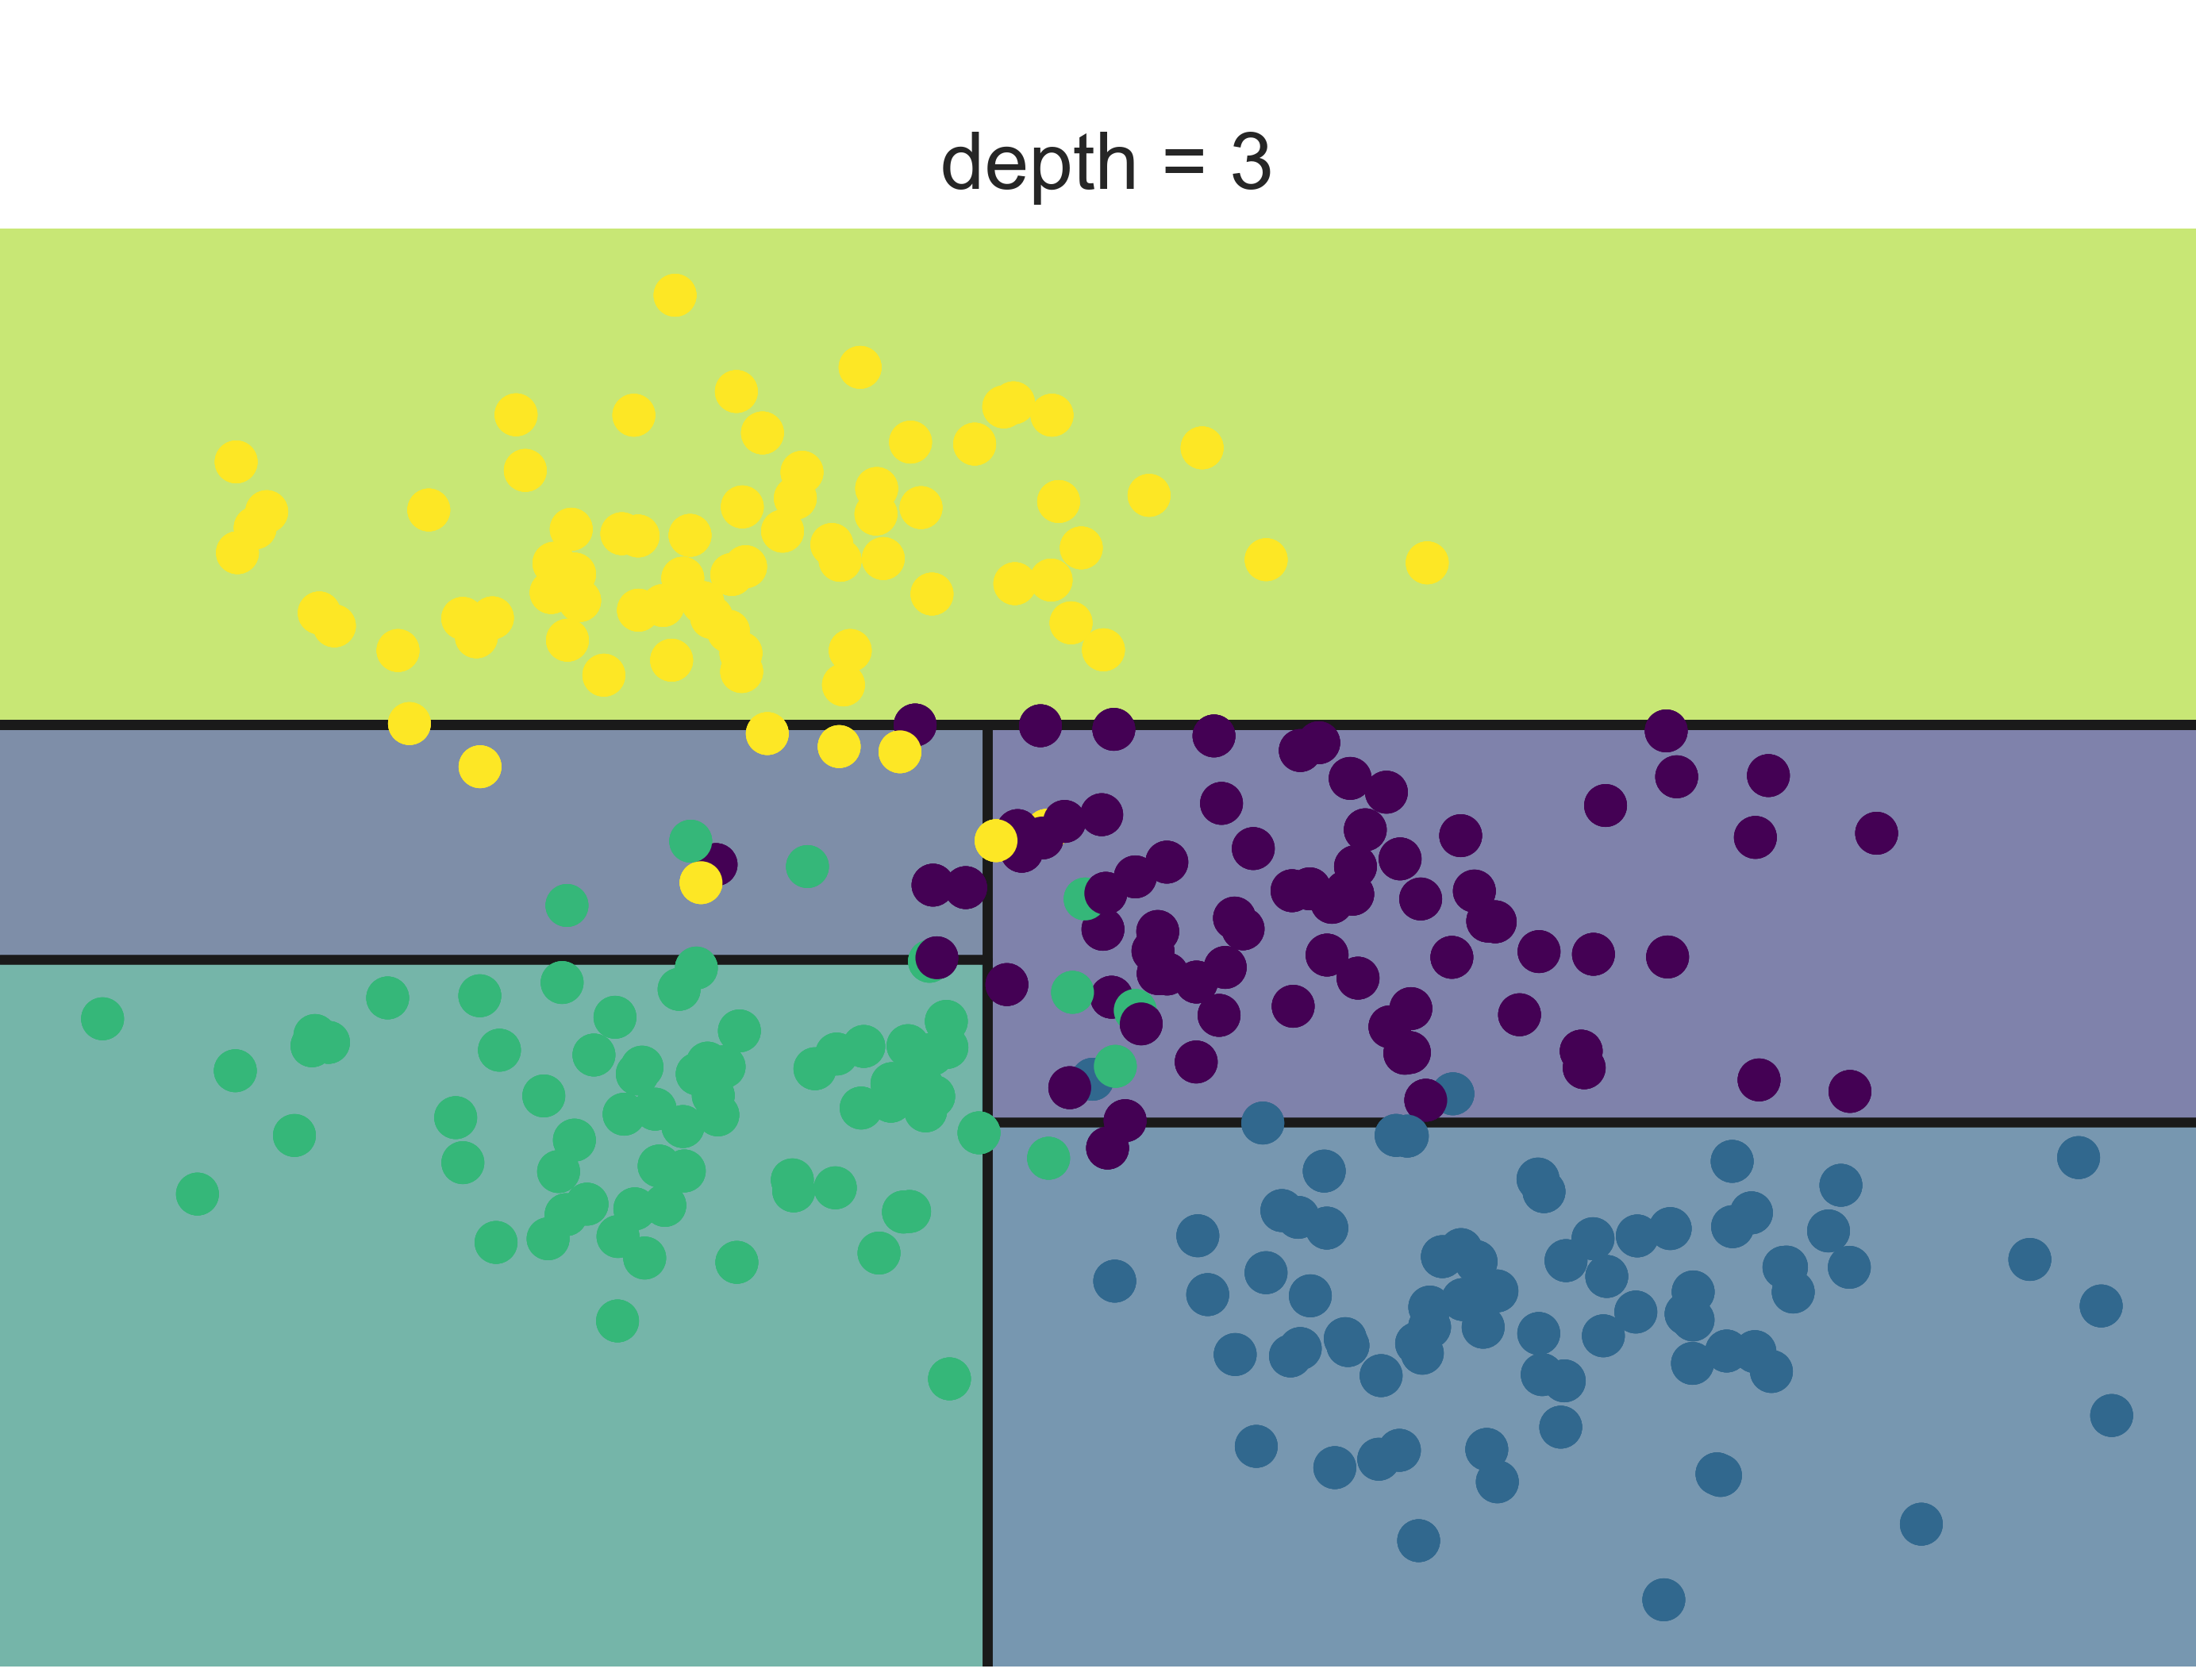
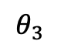
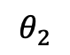
DTs example
$$x_{2}>θ_{1}$$
$$x_{1}>τ_{1}$$
$$x_{2}$$
yellow
$$θ_{1}$$
$$θ_{2}$$
$$θ_{3}$$
$$x_{2}<θ_{2}$$
$$x_{2}>θ_{3}$$
$$τ_{1}$$
$$x_{1}$$
purple
Green
blue
purple

Slide 33
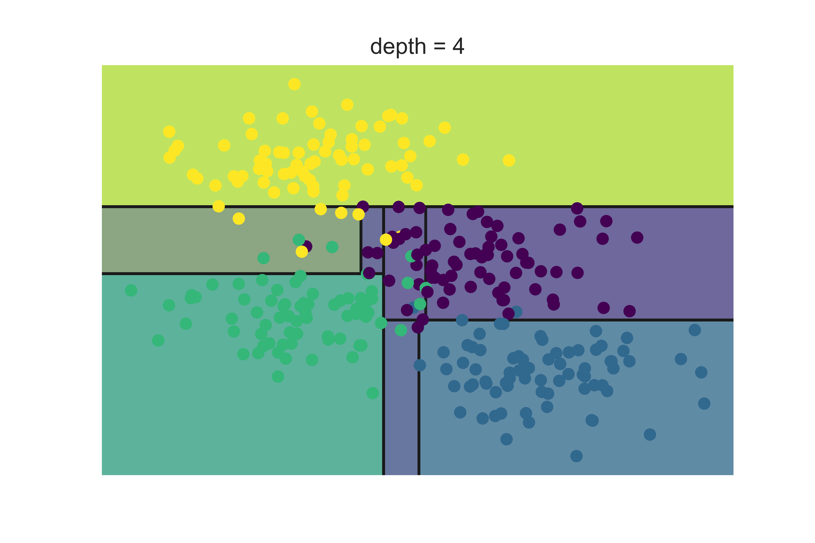
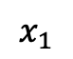
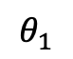
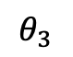
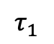
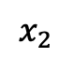
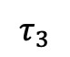
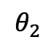
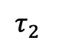
DTs example
The process is iterative..
When to stop?
$$x_{2}$$
$$θ_{1}$$
$$θ_{2}$$
$$θ_{3}$$
$$τ_{3}$$
$$τ_{2}$$
$$τ_{1}$$
$$x_{1}$$

Slide 34
DTs demo
Homes in San Francisco vs New York
Guess (classify) the location based on homes features
Elevation
Year built
Bathrooms
Bedrooms
Price
Prediction: San Francisco or New York

Slide 35
Building a DT
What is a good DT?
How to define the error?
How to split?
When to stop?

Slide 36
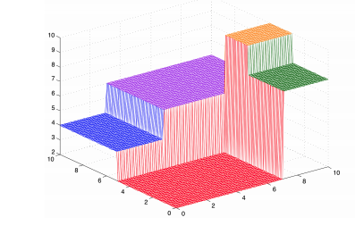
Building a DT
What is a good DT?
Homogenous space
Same elements in same region: low error

Slide 37
Building a DT
How to define the error?
Count misclassification
Measure of homogenous

Slide 38
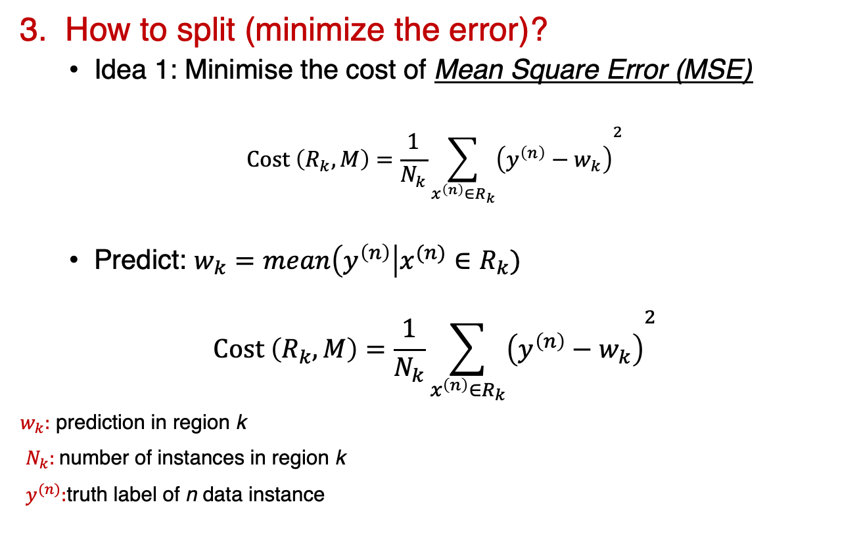
Building a DT
3. How to split (minimize the error)?
Idea 1: Minimise the cost of Mean Square Error (MSE)
$$Cost \left(R_{k}, M\right)=\frac{1}{N_{k}}{\sum_{x^{\left(n\right)}∈R_{k}}{\left(y^{\left(n\right)}−w_{k}\right)}}^{2}$$
Predict: $w_{k}=mean\left(y^{\left(n\right)}\right|x^{(n)}∈R_{k})$
$$Cost \left(R_{k}, M\right)=\frac{1}{N_{k}}{\sum_{x^{\left(n\right)}∈R_{k}}{\left(y^{\left(n\right)}−w_{k}\right)}}^{2}$$
$w_{k}:$ prediction in region k
$N_{k}:$number of instances in region k
$y^{(n)}:$truth label of n data instance

Slide 39
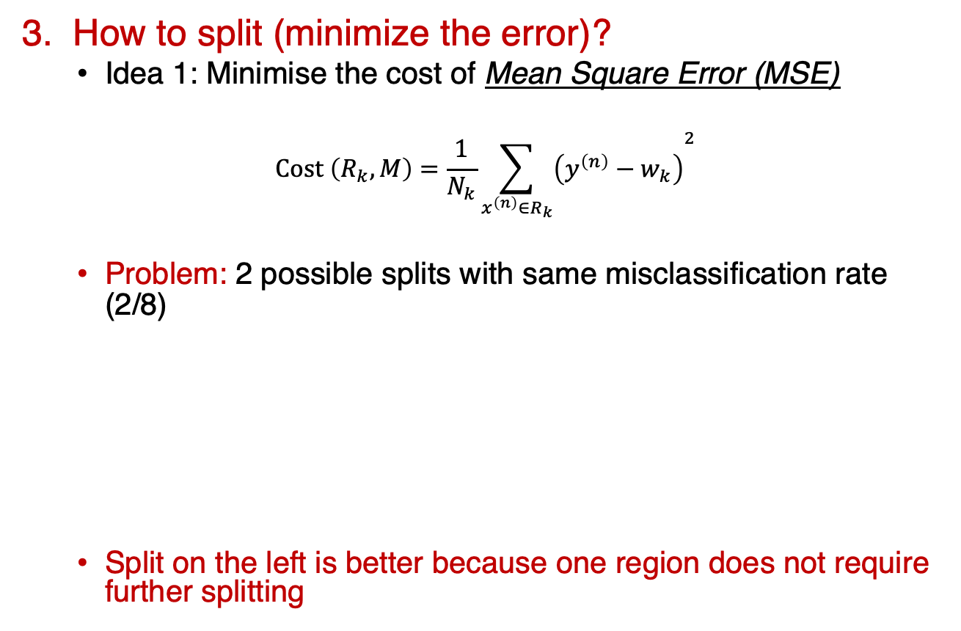
Building a DT
3. How to split (minimize the error)?
Idea 1: Minimise the cost of Mean Square Error (MSE)
$$Cost \left(R_{k}, M\right)=\frac{1}{N_{k}}{\sum_{x^{\left(n\right)}∈R_{k}}{\left(y^{\left(n\right)}−w_{k}\right)}}^{2}$$
Problem: 2 possible splits with same misclassification rate (2/8)
Split on the left is better because one region does not require further splitting
4 Blue
4 Yellow
4 Blue
4 Yellow
3 Blue
1 Yellow
1 Blue
3 Yellow
4 Blue
2 Yellow
2 Yellow

Slide 40
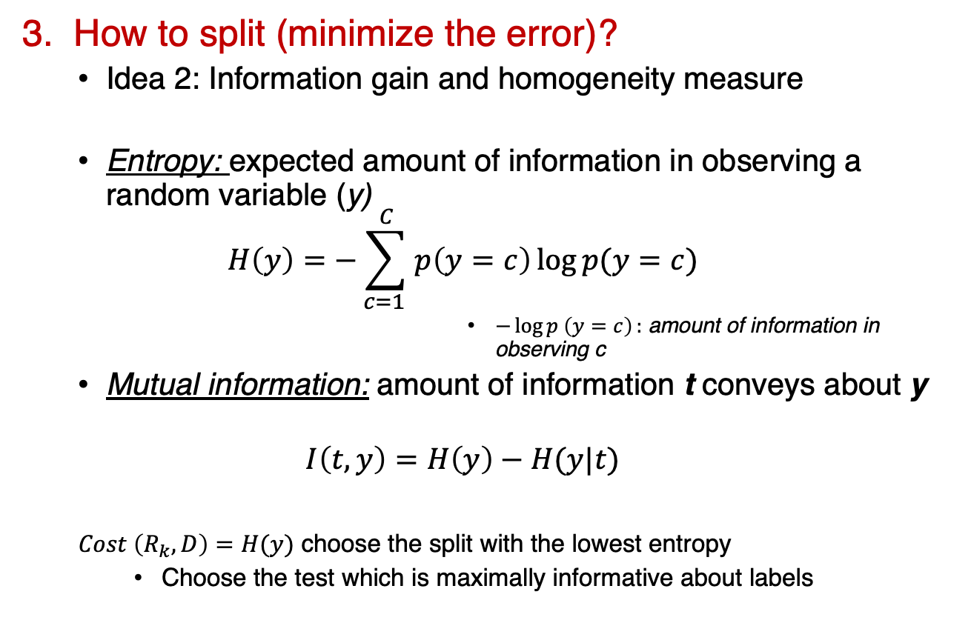
Building a DT
3. How to split (minimize the error)?
Idea 2: Information gain and homogeneity measure
Entropy: expected amount of information in observing a random variable (y)
$$H\left(y\right)=−\sum_{c=1 }^{C}{p\left(y=c\right)\log{p(y=c)}}$$
$−\log{p \left(y=c\right)}:$ amount of information in observing c
Mutual information: amount of information t conveys about y
$$I\left(t, y\right)=H\left(y\right)−H(y|t)$$
$Cost \left(R_{k}, D\right)=H(y)$ choose the split with the lowest entropy
Choose the test which is maximally informative about labels

Slide 41
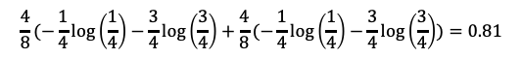
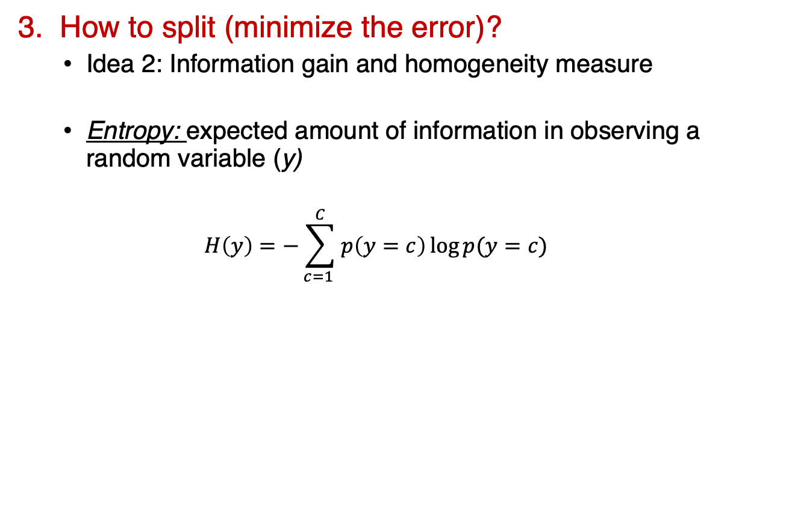
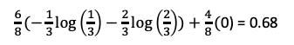
Building a DT
3. How to split (minimize the error)?
Idea 2: Information gain and homogeneity measure
Entropy: expected amount of information in observing a random variable (y)
$$H\left(y\right)=−\sum_{c=1 }^{C}{p\left(y=c\right)\log{p(y=c)}}$$
4 Blue
4 Yellow
4 Blue
4 Yellow
3 Blue
1 Yellow
1 Blue
3 Yellow
4 Blue
2 Yellow
2 Yellow
$$\frac{4}{8}(−\frac{1}{4}\log\left(\frac{1}{4}\right)−\frac{3}{4}\log\left(\frac{3}{4}\right)+\frac{4}{8}(−\frac{1}{4}\log\left(\frac{1}{4}\right)−\frac{3}{4}\log\left(\frac{3}{4}\right))=0.81$$
$\frac{6}{8}(−\frac{1}{3}\log\left(\frac{1}{3}\right)−\frac{2}{3}\log\left(\frac{2}{3}\right))+\frac{4}{8}($0) = 0.68

Slide 42
Building a DT
When to stop?
DTs are prone to overfitting
Trial and error
Hyper-parameters tuning
Validation sets

Slide 43

Break
15 minutes

Slide 44
DTs coding session
Notebook link
Colab / Jupyter notebook

Slide 45


Artificial Neural Networks (ANNs)
It begins with a neuron
https://cs231n.github.io/neural-networks-1/

Slide 46


Building ANNs
Activation function
Based on the input signal, fire the neuron or not
Make a decision: 0 / 1
Squash the input into a value between 0 and 1
Sigmoid function: $σ\left(x\right)=\frac{1}{(1+e^{−x})}$

Slide 47








Building ANNs
$$x_{1}$$
$$w_{1}$$
$$Sum weighted inputs and \\ Activation function$$
$$x_{2}$$
$$w_{1}$$
$$y$$
$$w_{1}$$
$$x_{3}$$

Slide 48










Building ANNs
$$X=\left[2, 3, 1\right] \\ W_{0}=[0.4, 0.1, 0.3] \\ y_{true}=0$$
$$5$$
$$0.4$$
$$Sum weighted inputs and \\ Activation function$$
$$3$$
$$0. 1$$
$$y$$
$$0.3$$
$$\sum{w_{i}x_{i}=2.6}$$
$$σ\left(2.6\right)=1$$
$$y_{pred}=1$$
$$1$$

Slide 49




Building ANNs
$$X=\left[2, 3, 1\right] \\ W_{1}=[−0.4, 0.1, −0.3] \\ y_{true}=0$$
$$5$$
$$0.4$$
$$Sum weighted inputs and \\ Activation function$$
$$3$$
$$0. 1$$
$$y$$
$$0.3$$
$$\sum{w_{i}x_{i}=−2}$$
$$σ\left(−2\right)=0$$
$$y_{pred}=0$$
$$1$$

Slide 50

Building ANNs
How did we change the weights from $W_{0} to W_{1}$
This is the core of ANNs!
Iterative modification of the weights
Learning algorithms:
Gradient descent
Stochastic gradient descent
Adam
Feedforward and backward loops

Slide 51
ANNs architecture

Slide 52
ANNs demo
ANNs in action

Slide 53
ANNs coding session
Notebook link
Colab / Jupyter notebook

Slide 54

Important concepts
Categorical variables
One hot encoding
Convert categorical to numerical
Label
A
B
C
A
A
B
C
Label
1
2
3
1
1
2
3

Slide 55

Important concepts
You need to clean the data
Remove NaN and null values
Pandas: pd.dropna()

Slide 56

Performance metrics
Accuracy is only one metric
Definition: proportion of correct cases to all cases
$$Accuracy=\frac{True Positive+True Negative}{Tue Positive+True Negative+False Positive+False Negative}$$
Actual
 | Positive | Negative
Positive | True positive | False Positive
Negative | False Negative | True Negative
Predicted

Slide 57

Performance metrics
Cancer detection test with 99.7% accuracy (impressive?)
100,000 patients
1,000 Malignant (Positive)
99,000 Benign (Negative)
$Accuracy=\frac{850+98,820}{100,000}=99.7\%$
Question 1:
Of all patients that we predicted to have cancer, how many actually have Cancer?
$Precision=\frac{True positive}{True positive+False positive}=\frac{850}{850+180}=82.5\%$
Percentage of results which are relevant
Actual
 | Positive | Negative
Positive | 850 | 180
Negative | 150 | 98, 820
Total | 1,000 | 99,000
Predicted

Slide 58

Performance metrics
Cancer detection test with 99.7% accuracy (impressive?)
100,000 patients
1,000 Malignant (Positive)
99,000 Benign (Negative)
$Accuracy=\frac{850+98,820}{100,000}=99.7\%$
Question 2:
Of all patients that have Cancer, how many did we get right?
$Recall=\frac{True positive}{True positive+False negative}=\frac{850}{850+150}=85\%$
Percentage of total relevant results correctly classified
Actual
 | Positive | Negative
Positive | 850 | 180
Negative | 150 | 98, 820
Total | 1,000 | 99,000
Predicted

Slide 59

Performance metrics
Confusion matrix
For binary and multi-class classification
Correct elements are the diagonals
https://ml4a.github.io/demos/confusion_mnist/

Slide 60
Performance metrics
Accuracy is only one metric
Precision and recall
Confusion matrix
Critical for unbalanced datasets

Slide 61
Break
15 minutes

Slide 62
Coding competition
Work on Titanic dataset

Slide 63

Coding competition
Work on Titanic dataset
Work in groups
Compare DTs, ANNs, and SVMs
30 minutes
Go!

Slide 64
Coding competition
Work on Titanic dataset
Work in groups for 30 minutes
Requirements:
Compare DTs and ANNs
Hyper-parameters tuning?
Apply performance metrics
3 minutes presentation
Bonus: Apply Support Vector Machines (SVM)?
Go Go Go!

Slide 65
Deep Learning
Evolution of ML
Exploits abundance of data
Automatic extraction of features

Slide 66
Deep Learning
Convolutional Neural Networks

Slide 67
Deep Learning
Recurrent Neural Networks

Slide 68
Next steps
Introductory books:
The Elements of Statistical Learning
Information Theory, Inference, and Learning Algorithms
Understanding Machine Learning: From Theory to Algorithms
Dive into Deep Learning
Online resources
Online courses: EdX, Coursera, ...
Datasets and competitions: Kaggle, IEEEDataPort, …
Online articles: Towards Data Science, Medium, …
Google is great ☺

Slide 69
References
http://cs231n.stanford.edu/
https://www.siamak.page/courses/COMP551F20/index.html
https://homes.cs.washington.edu/~pedrod/papers/cacm12.pdf

Slide 70
Questions?

Slide 71

Questions?

Slide 72
Questions?
Github repo
https://github.com/abdelrahman-ayad/MiCM-introML-W21
Contact info:
abdelrahman.ayad@mcgill.ca

